Slide 1
C# Object Oriented Programming

Slide 2
Four pillars of Object Oriented Programming
Encapsulation
Avoid direct access to data (data hiding)
Inheritance
Reusing and adding new abilities
Polymorphism
Objects with different types can be accessed through the same interface
Same name of function, difference in behaviors
Abstraction
What – not how

Slide 3
Core concepts
Class & Object, UML Class diagram
Override & Overloading
Abstract class
Interface

Slide 4
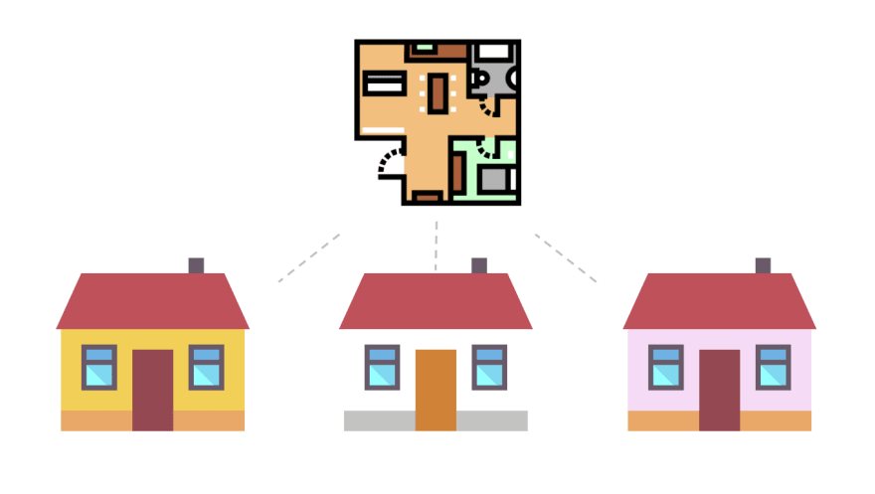
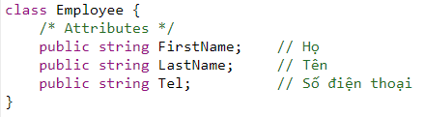
Class
A blueprint to create objects
Class House
House 1
House 2
House 3

Slide 5
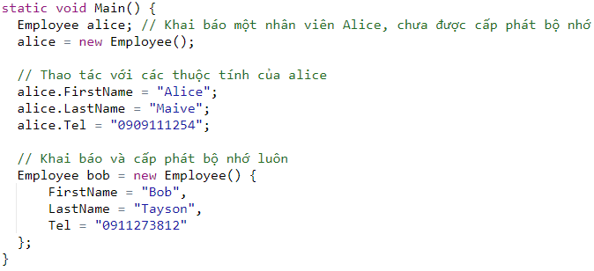
Object
A specific instance created from a class
How many classes are there? How many instances are there?

Slide 6

Common misunderstanding & error for beginners

Slide 7
Destructor
No need because we have an automatic Garbage Collector

Slide 8

What does a class have?
Attributes (data)
Behaviors (functions)
Attributes: weight, height
Behaviors: eat, sleep, run
When a cat eats, what changes?
When a cat sleep, what changes?

Slide 9

Behaviors can change attributes
eat
sleep

Slide 10
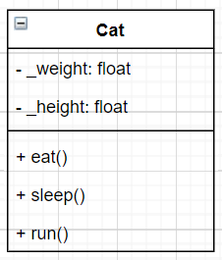
Represent a cat with UML
Universal Modeling Language
Attributes
Behaviors

Slide 11
Note
Class is a blueprint of an object
Object is an instance of a class
A class has attributes & behaviors
Behaviors can change an object’s attributes
Use UML to model a class
Abstraction: focus on what is important

Slide 12
In-class exercise
Create UML diagram using draw.io (or your favourite) for
1. A soldier that has Hit points and Mana, can attack and defend
2. An Autobot transformer that can toggle between vehicle form and robot form, fly, fight and escape. Its life depends on its energy in W (wattage)
Submit back the image in this format: StudentID.png/jpg

Slide 13
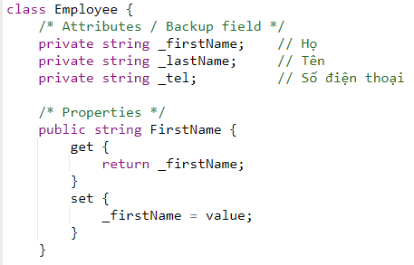
Encapsulation - Getter & Setter
Avoid direct access to attribute

Slide 14
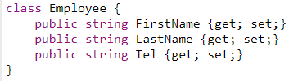
Shortcut for encapsulation

Slide 15
Why should we use getter & setter?
May be adding business logic later
For example: your account has a balance of 200.000, you cannot withdraw 300.000
Isolation, good for maintenance
Derivative properties
UI programming: databinding!
UI elements automatically update based on the databound variable

Slide 16
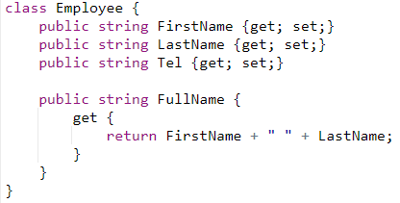
Derivative property

Slide 17
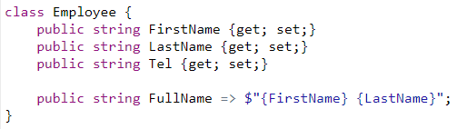
Lambda expression

Slide 18
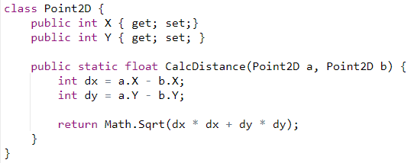
Static function

Slide 19
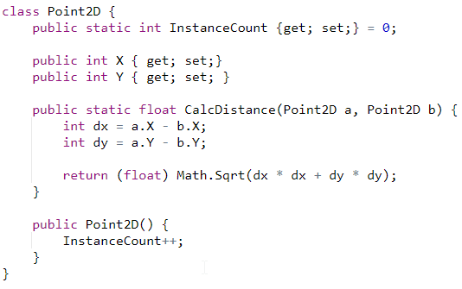
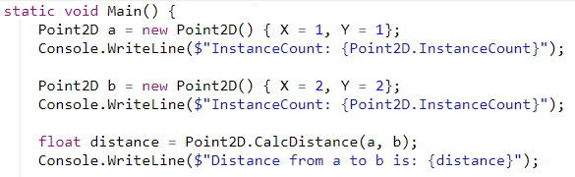
Static attribute / Property

Slide 20
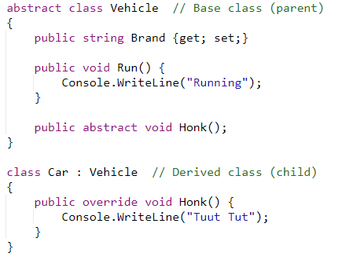
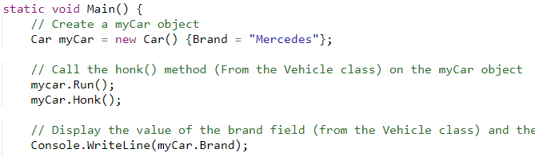
Inheritance - Reuse & Upgrade

Slide 21
Examples of inheritance - Reuse & Upgrade
Point3D from Point2D
Person > Student > Teacher
Employee > DailyEmployee > ProductEmployee > Manager
Shape > Rectangle > Square > Circle > Ellipse
Character > Knight > Swordman > Pikeman

Slide 22
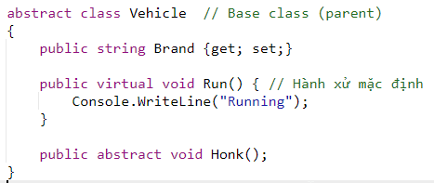
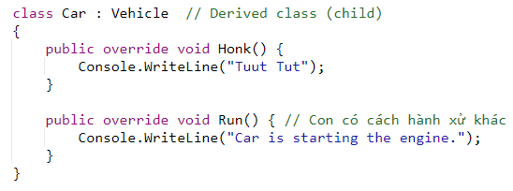
Overriding

Slide 23
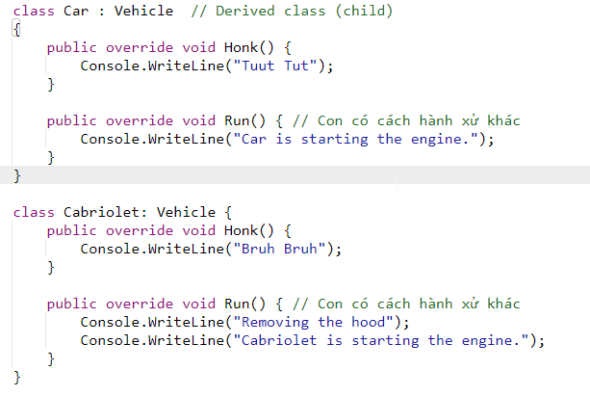
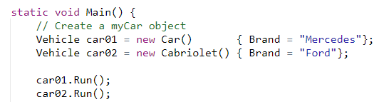
Polymorphism

Slide 24
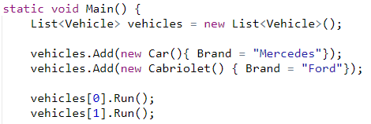
Array of objects

Slide 25
Multiple inheritance
C# does not support multiple classes inheritance
But we have multiple interfaces inheritance

Slide 26
In-class exercise
A student will have this information: StudentID, FullName, GPA, Address
Generate random 10 students
Print out the average GPA of all the students
Print out full information of the top 3 students with the highest GPA
Name the project: RandomStudents, submit back the onlinedgb / VS project link.

Slide 27
Instructions (extra work)
StudentID: Length is 8, first two numbers: year 18/19/20 => Next 6 digits is random (0-9)
Fullname: Firstname (Trần/Nguyễn/Lê/Lý/Đỗ/Đặng)
MiddleName: Tấn / Việt / Đức / Nhật / Khắc
Name: Quang / Minh / Thu / Thủy / Thắng
GPA: random 0-10
Address: Number (1-100), street name (Nguyễn Đình Chiểu, Hoàng Hoa Thám, CMT8, Quang Trung, Nguyễn Huệ), Ward (1-10), District (1-10/BinhTan/TanPhu)

Slide 28
References
https://www.w3schools.com/cs/cs_oop.asp

Slide 29
Parsable (.Net 7+)
Parse(String, IFormatProvider)
TryParse(String, IFormatProvider, TSelf)
Static polymorphism
https://learn.microsoft.com/en-us/dotnet/api/system.iparsable-1?view=net-7.0

Slide 30
Extension method
https://learn.microsoft.com/en-us/dotnet/csharp/programming-guide/classes-and-structs/extension-methods

